Slide 1


Ethereum Blockchain

Slide 2
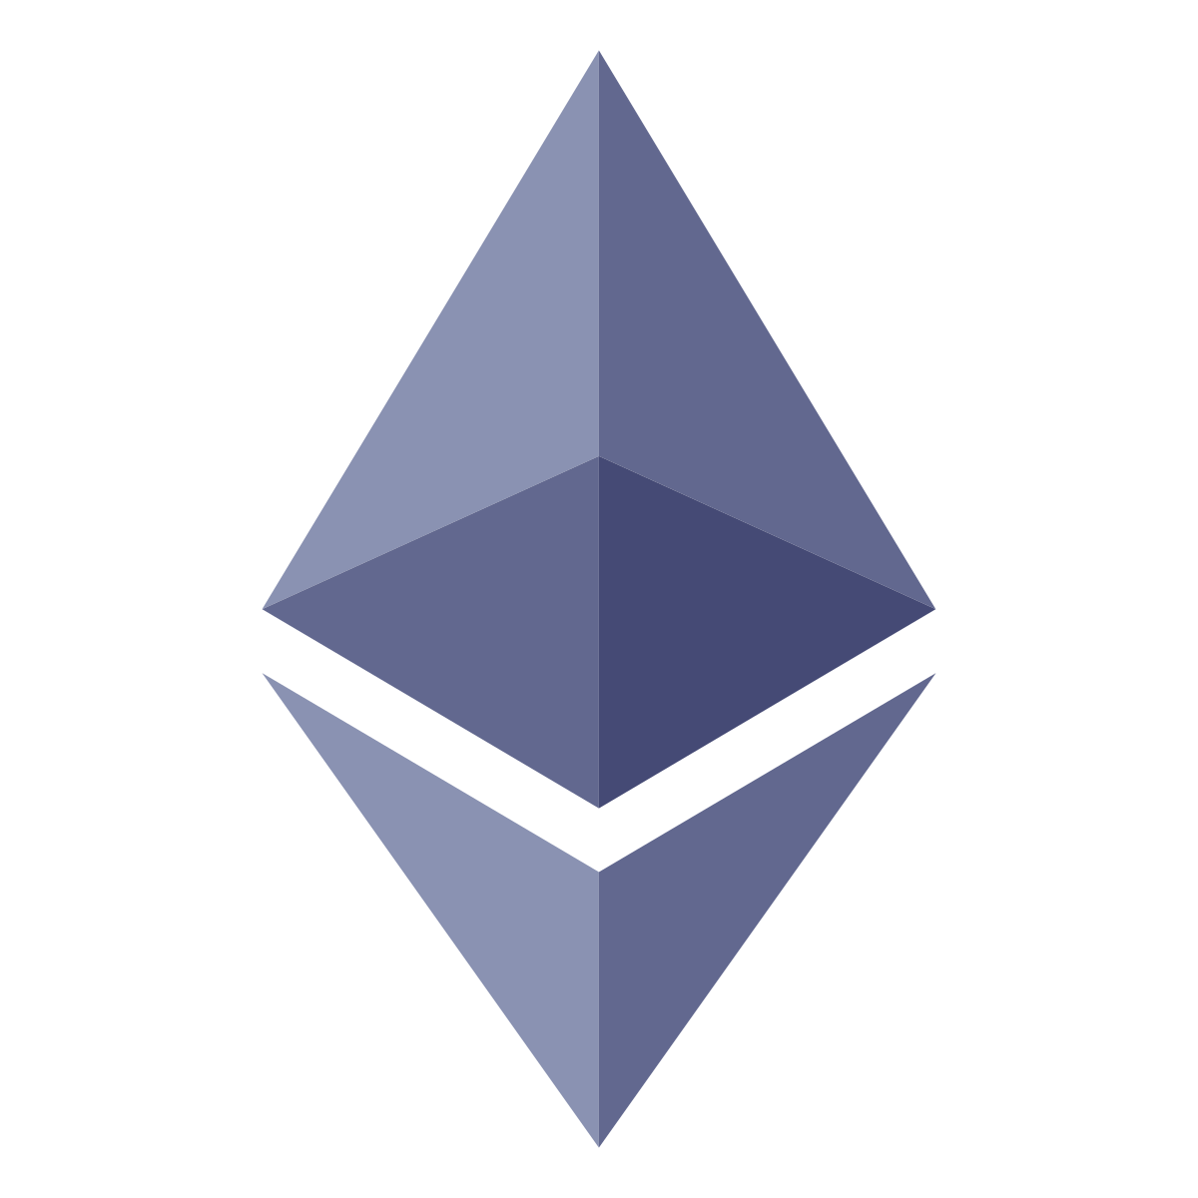
Introduction to Ethereum
Ethereum is a decentralized platform that runs smart contracts and has its own
cryptocurrency known as Ether.

Slide 3


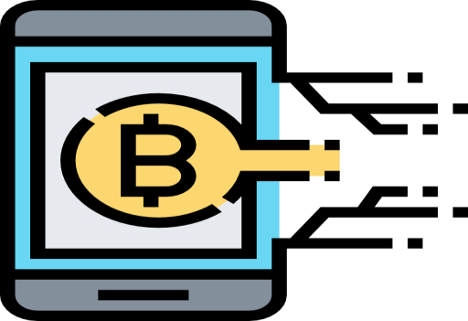



Features of Ethereum
Smart Contracts
Currency
Fast Transactions
Automated programs that execute upon satisfying certain conditions
They have Ethers based on ERC-20 tokens
Mining speeds are very high and transactions are completed in 10-
12 seconds
Community
Security
Ethereum has extensive developer community support
Ethash and smart contracts are used to enhance security

Slide 4


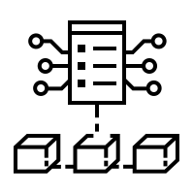

Ethereum Ecosystem
The Ethereum ecosystem consists of technologies that help enable decentralized browser and applications such as storage, dynamic communication, and distributed computation.
DApp
DApp
DApp
Decentralized Browser
Storage
Communication
Computation
Ethereum Blockchain

Slide 5

Swarm
Swarm is a censorship resistant, permissionless, and
decentralized file share and storage platform.
It stores Ethereum records to distribute blockchain
data as well as Dapp codes throughout the network.
It runs on a peer-to-peer basis that allows to transfer
resources/data among the nodes.

Slide 6
Smart Contract
Smart contracts are computer programs that are
stored on Ethereum’s Blockchain.
Contracts can be used to build currencies and store financial assets.
They are used to design voting systems, decentralized organizations, data feeds, title registries, and thousands of other applications.

Slide 7



Smart Contract Languages
Contracts are compiled into bytecode on the Ethereum Virtual Machine and deployed to Ethereum Blockchain for execution.
Various languages may be used to write these contracts, but the below mentioned ones are the most popular:
Solidity
Julia
Vyper

Slide 8
Ethereum Virtual Machine (EVM)
Smart Contract Byte Code
Storage
Ethereum Virtual Machine
Node
Ethereum Virtual Machine (EVM) is the runtime environment for the smart contracts in Ethereum.
Developers can create applications that run on the EVM using user-friendly programming languages such as Solidity.
The EVM is sandboxed and completely isolated to protect the host computers from the threat of viruses or malicious intrusion attempts.

Slide 9
Ether
Ether is the primary digital asset or cryptocurrency of the Ethereum platform.
It is a transactional token that facilitates operation on
Ethereum.
All Gas prices are paid in Ethers.

Slide 10
Bitcoin Vs Ether
Bitcoin | Ether
Uses secure hash algorithm (SHA-256) | Uses Ethash algorithm
Used as currency for purchasing goods and services | Used as a currency and for making decentralized apps
Digital currency to compete against fiat currencies and gold | Mainly used for smart contracts
Transaction speed is slower | Transaction speed is much faster
Very high mining price | Lower Gas prices comparatively

Slide 11


Gas
Gas is a unit of measuring the amount of computational power required to run a smart contract or perform a transaction. It is similar to a transaction fee for every operation performed on Ethereum Blockchain.
The Gas Limit is the maximum amount of Gas that a user is willing to pay for performing an action or confirming a transaction (a minimum of 21,000).
The Gas Price is the amount of Ether that the user is
willing to spend on each unit of Gas.
The transaction fee is calculated as Gas Limit * Gas Price

Slide 12


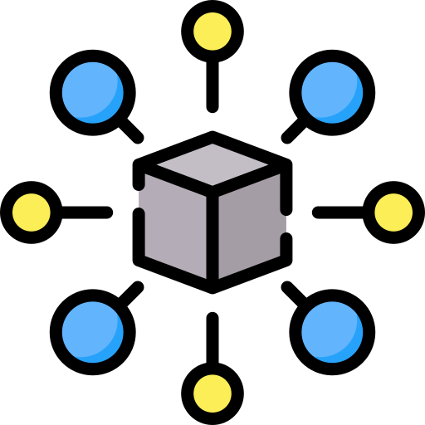
Decentralized Application (DApp)
DApps are applications that run on a decentralized, distributed, peer-to-peer network, and do not have a central authority controlling the application platform.
Their codes are open source and all users can access
them irrespective of the region they reside in.
All DApps run on the Blockchain network on top of
smart contracts.

Slide 13
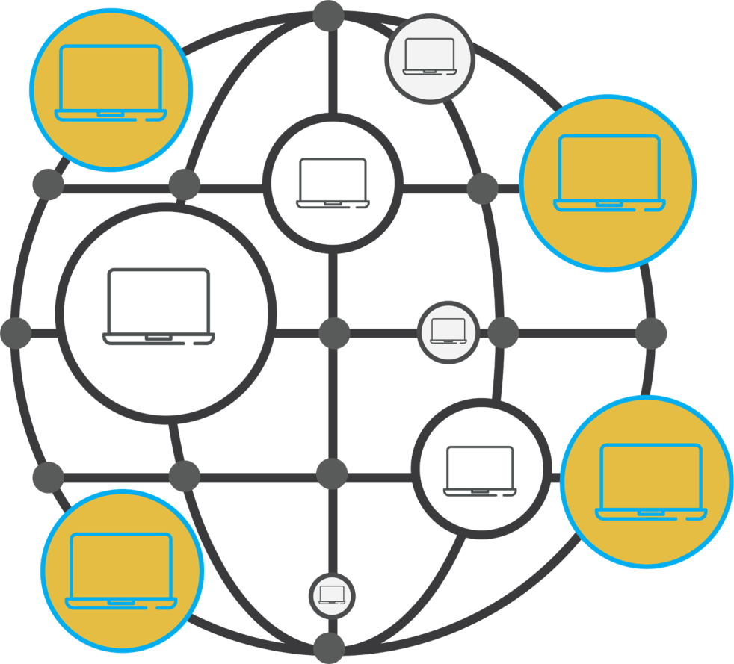
Decentralized Autonomous Organizations (DAO)
DAOs are internet-based business organizations which are fully democratized and have no hierarchical management.
DAOs are designed to hold the common assets and use a voting system to utilize these assets.
DAOs exist entirely on Blockchain and are governed by the consensus protocols embedded into smart contracts.

Slide 14

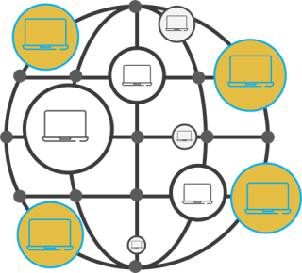
Features of DAO
Improved stability
Negligible downtime
Higher reliability
No third-party involvement
Asset misutilization almost impossible
Enhanced privacy and security

Slide 15

Ethereum Networks
Networks are different Ethereum environments that you can access for developing, testing, and
releasing various decentralized applications. They are categorized into the following types:
The actual Ethereum network on which the cryptocurrency
transactions take place.
Mainnet
This network mimics the mainnet and can be used by developers
to test their applications.
Test Network
This can be implemented by changing the parameters of the
Ethereum network according to the needs of the user.
Private Network

Slide 16

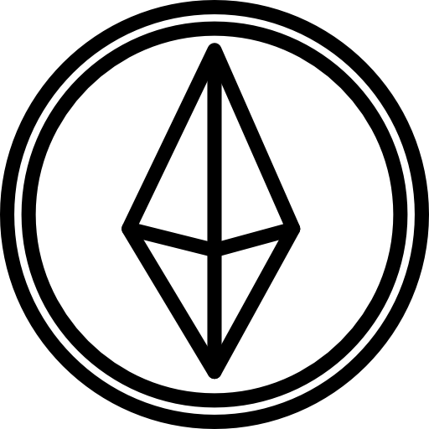
Main Network (Mainnet)
Mainnet is the live or production network of the Ethereum Blockchain. This is the network on
which the actual monetary transactions take place, and the Dapps are hosted on.

Slide 17

Test Networks
Ethereum provides a few test networks to developers which can be used to test their protocols, smart contracts, features, and applications before deploying them to the production network.
Ropsten
Proof-of-Work network,
which mimics the mainnet
Görli
Proof-of-Authority network
for all clients
Kovan
Proof-of-Authority network
for OpenEthereum clients
Rinkeby
Proof-of-Authority network
for Geth clients

Slide 18

Ganache: Local Network
Ganache is a lightweight replica of the Ethereum Blockchain.
It can be installed on any operating system and
replicates the actual Blockchain network.
It is mainly used by developers for smart contract
unit testing.

Slide 19
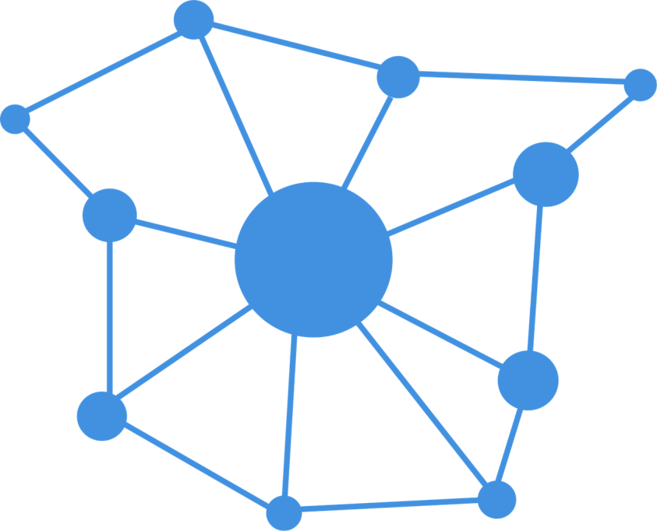

Private Network
Ethereum does provide the capability to create your own private network with custom parameters. Private networks are not very popular in Ethereum but they do exist.

Slide 20
Ethereum Wallets
Ethereum wallets help in connecting with the Ethereum Blockchain network, storing Ether, and
performing monetary transactions from one account to another.

Slide 21
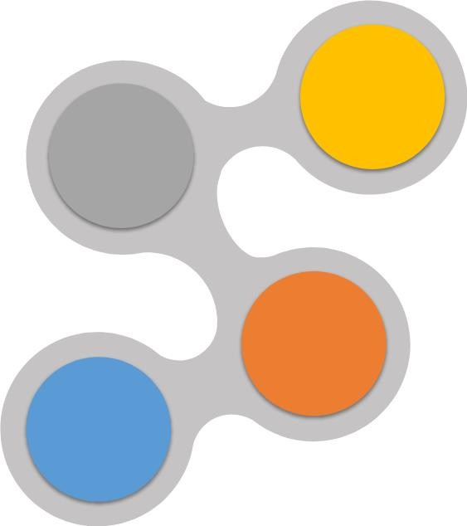




Types of Ethereum Wallets
Ethereum wallets are mainly categorized into the below types:
Desktop Wallets
Web Wallets
Installed on desktops to
perform transactions
Installed as an extension to web browsers
Mobile Wallets
Light-weight mobile
applications
Hardware Wallets
Most secure as they store
keys in physical devices

Slide 22


Metamask
Metamask is a web wallet that allows users to send and receive Ethers and other Ethereum-based cryptocurrencies.
It also acts as a gateway to interact with other
decentralized apps.
It keeps the private information secure, and uses randomly generated multi-word phrases as opposed to traditional single-word passwords.

Slide 23

Mist Wallet
It is a web and desktop wallet developed by the founders
of Ethereum.
It was initially developed as a browser for accessing Dapps
and the wallet was a Dapp built into the browser.
It is used for transacting, and storing Ethers, creating multi-
signature wallets, and deploying smart contracts.

Slide 24
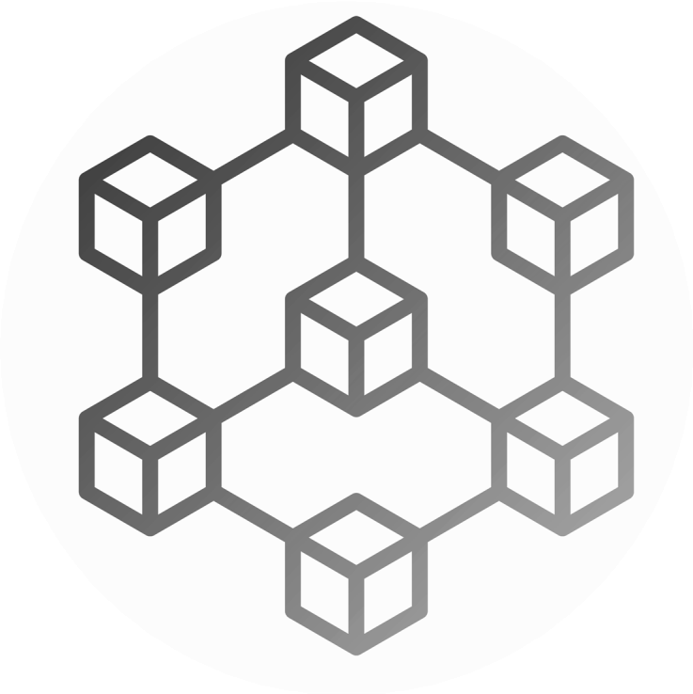


Ethereum Clients
Ethereum clients provide an interface to become full nodes. They can then verify transactions, parse Blockchain and smart contract data, and mine and create blocks.
Gateway
to Mainnet
System
Client
Client
System
Ethereum Blockchain Network

Slide 25
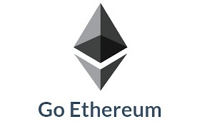

Types of Ethereum Clients
Ethereum clients are mainly categorized in the below types:
Command Line Interface Graphical User Interface
A terminal-based application which is used to perform the functions of a full node
A visual interface that can be used as a web/desktop application to perform full/light node activities

Slide 26

Go Ethereum (Geth)
Geth is a terminal-based Ethereum client implemented in the Go language. It was developed by the
Ethereum foundation and provides a command line interface for exercising full node powers.
Features of Geth
Mine blocks and earn Ether
Perform transactions and transfer funds
Validate transactions and interact with smart contracts
Update and maintain Blockchain history

Slide 27
Connecting to Ethereum Using Geth
Geth allows us to connect to Ethereum mainnet, Ropsten, and Rinkeby network. Geth does not allow us to connect to the Kovan network. We need to use Parity for that.
Command to connect to the Main network
geth
Command to connect to the Ropsten network
geth --ropsten
Command to connect to the Rinkeby network
geth --rinkeby

Slide 28



Geth Data Storage
Geth client connects with the other peers and downloads the latest Blockchain data to the local machine. Data gets stored in below locations and it can be changed with the --datadir parameter.
Linux
~/.ethereum
Windows
~/AppData/Roaming/Ethereum
Mac
~/Library/Ethereum

Slide 29

Parity
Parity is a light-weight, fast, and multi-network Ethereum client written in the Rust language. This is one of the most commonly used third-party Ethereum clients.
Features of Parity
Clean, modular codebase for easy
customization
Minimal memory and storage footprint
Synchronize the updated Blockchain in a few hours as compared to a few days in other clients

Slide 30
Connecting to Ethereum Using Parity
Parity client allows us to connect to the Ethereum mainnet, Ropsten, and Kovan network.
Command to connect to the Main network
parity --chain=mainnet
Command to connect to the Ropsten network
parity --chain=ropsten
Command to connect to the Kovan network
parity --chain=kovan

Slide 31



Parity Data Storage
Parity is a lightweight Ethereum client that helps connect to the peers and synchronize the latest
Blockchain data into the local machine. It stores the Blockchain data into the following folders:
Linux
~/home/you/.local/share/io.parity.ethereum
~/AppData/Local/Parity/Ethereum
Windows
Mac ~/Library/Application Support/io.parity.ethereum

